Slide 1
amazon fine FOOD reviews sentiment analysis
Mira Havens
Notes:
© Copyright PresentationGo.com – The free PowerPoint library

Slide 2
Agenda
Introduction
Introduction
Exploratory Data
Data wrangling
Modeling
Methodology
Conclusions
Conclusions
Motivation
Data
Inferential statistics
Findings
Modeling framework
Modeling results
Improvements

Slide 3
Introduction
Motivation:
Customer reviews play a crucial role in online shopping. As a customer centric company, we want to provide best shopping experience, so our goal of the analysis is to classify reviews as helpful or not helpful. Customers can then have more information to make purchasing decisions.
Data:
1. Time Frame : 2002-2012
2. Observations : 568,454
3. Variables : 9
Data Sources : Link

Slide 4
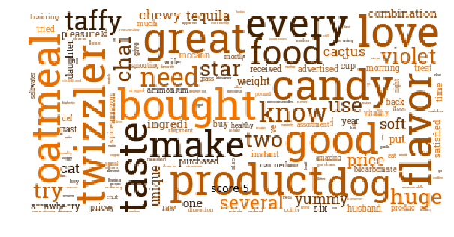
Exploratory Data

Slide 5
Exploratory Data
Insights :
Over 80% of reviews are rated as 4 or 5 stars, so positive reviews are very common.
Each review contains approximately 80 words.
Reviews with more words are more helpful.
Score rating will impact the reviews' helpfulness.
Top 5 most frequently used words in review summary.
1. Great 2. Good 3. Best 4. Love 5. Coffee
Top 5 most frequently used words in review text.
1. Like 2. Taste 3. Good 4. One 5. Flavor

Slide 6
Modeling

Slide 7
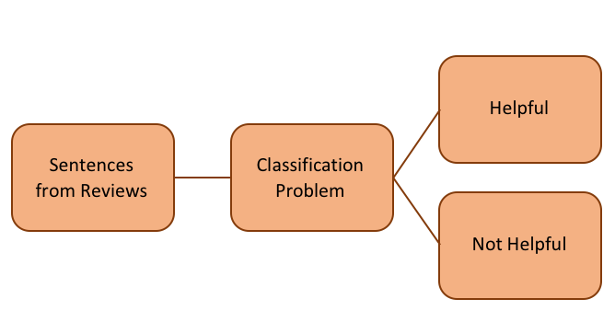
Modeling
Methodology:
The text classification uses a labelled dataset containing text and their label which is used to train a classifier. Our goal is to build a prediction model that is able to predict whether a review is helpful or not helpful.

Slide 8
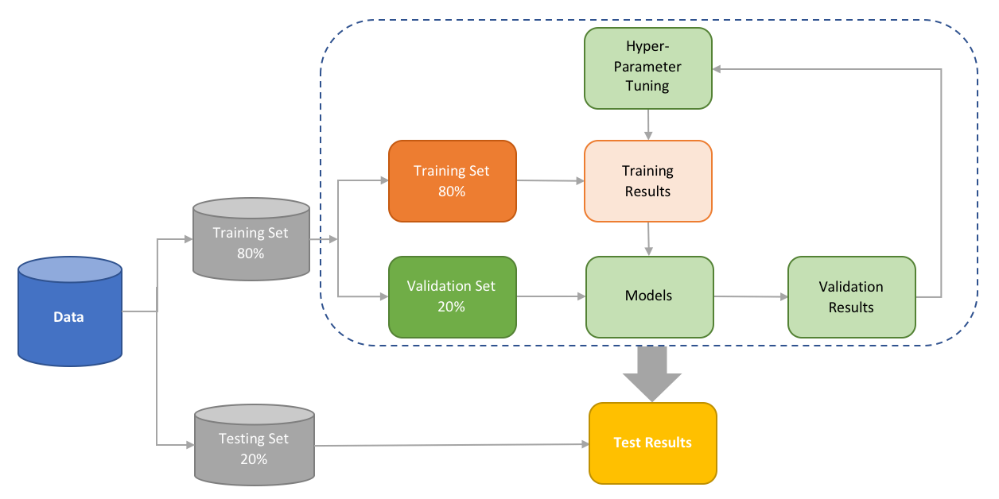
Modeling
Framework:

Slide 9
Modeling
1. Dataset Preparation:
Binary encoding where 1 = helpful and 0 = not helpful.
Split dataset into 80% training, 20% validation, 20% testing.
2. Feature Engineering:
Create sample pipeline for text feature extraction and evaluation
N-gram level TF-IDF
3. Model Training:
Algorithms: Naive Bayes, Logistic Regression, SVM, Random Forest and Ada-boost classifier.
Use a grid search with cross validation to optimize on the hyperparameters of each algorithm.
Select the model with highest accuracy.
4. Final Model Tuning and Optimization

Slide 10
Conclusions

Slide 11
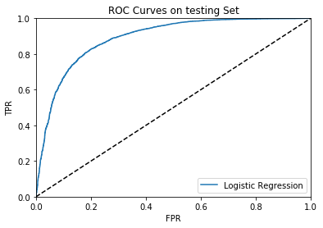
Conclusions
We observe that the area under the curve(AUC) is equal to 0.89.
The result shows that our Logistic Regression model has better performance to distinguish helpful and not helpful reviews.

Slide 12
Conclusions (cont.)
Results:
The average ROC score for 100 different random states is equal to 0.89, the same as our optimum solution. We can consider this model robust.
The final F1 score is equal to 0.83 and the precision and recall are also very close. This indicates our model has a good balance between sensitivity and specificity.
 | precision | recall | F1-score | Support
0 | 81% | 62% | 70% | 4,148
1 | 85% | 93% | 89% | 9,255
Avg./Total | 83% | 84% | 83% | 13,403

Slide 13
Conclusions (cont.)
Improvement:
To improve the accuracy of our model, the following actions could be taken:
Text cleaning: Conducting different ways to clean text will help to reduce noise.
Feature engineering: Generate different feature vectors (Ex: Character Level TF-IDF) or add NLP based features (Average Word Density of the reviews, Word Count of the reviews).
Training data: try a variety of classifiers (Ex : Deep Neural Networks Convolutional Neural Network (CNN) / Recurrent neural networks (RNN)).

Slide 14
Thank You

